Slide 1
STATISTICS FUNDAMENTALS

Slide 2
TODAY’S LEARNING OBJECTIVES
STATISTICS FUNDAMENTALS
Use NumPy and Pandas libraries to analyze datasets using summary statistics
Visualize data to discern characteristics in a dataset
Identify a normal distribution within a dataset using summary statistics and visualization
ID variable types and complete dummy coding by hand

Slide 3
COURSE
PRE-WORK

Slide 4
PRE-WORK REVIEW
Download a desktop Git Client
Clone/Sync Up with the DS-DC-15 Repository

Slide 5
OPENING
STATISTICS FUNDAMENTALS

Slide 6
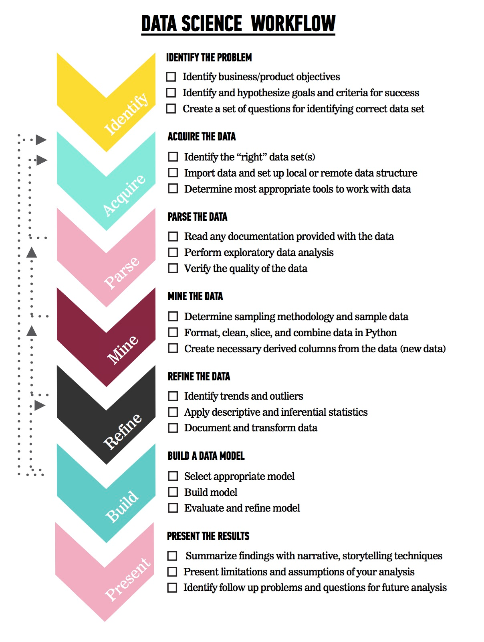
LET’S REVIEW THE DATA SCIENCE WORKFLOW
The steps:
Identify the problem
Acquire the data
Parse the data
Mine the data
Refine the data
Build a data model
Present the results

Slide 7
TODAY
We’re going to begin to talk about step 3: Parsing the Data
We’ll begin to talk about the fundamentals of Statistics

Slide 8
INTRODUCTION
DESCRIBING DATA

Slide 9
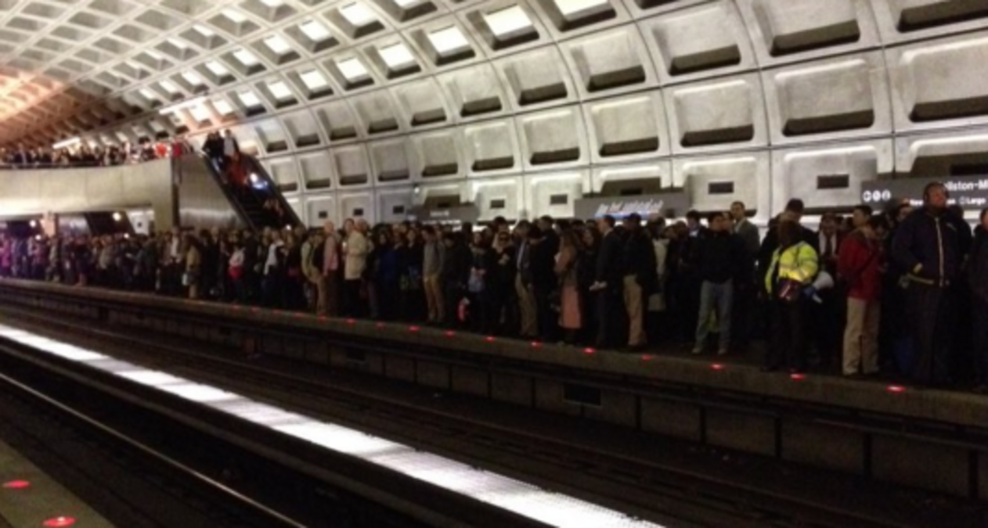
DC METRO EXAMPLE
Every night, WMATA submits a Disruptions Report representing any significant disruptions in metro service that day. You can find the dataset here (http://opendatadc.org/dataset/wmata-disruption-reports).
Let’s take a look at the disruptions they recorded for the weekend of 8/20.

Slide 10
DC METRO EXAMPLE
Day | Time | Color Line | Station | Delay
8/20/2016 | 8:24 a.m. | Green | Branch Avenue | 6
8/20/2016 | 11:37 a.m. | Red | Grosvenor | 18
8/20/2016 | 12:00 p.m. | Red | Glenmont | 4
8/20/2016 | 2:28 p.m. | Yellow | Ft. Totten | 12
8/20/2016 | 2:40 p.m. | Red | Glenmont | 4
8/20/2016 | 3:04 p.m. | Red | Grosvenor | 4
8/20/2016 | 5:14 p.m. | Orange | New Carrollton | 22
8/21/2016 | 9:15 a.m. | Red | Silver Spring | 8
8/21/2016 | 9:15 a.m. | Red | Silver Spring | 8
8/21/2016 | 11:32 a.m. | Blue | Franconia-Springfield | 2
8/21/2016 | 1:56 p.m. | Silver | Largo Town Center | 8
How would you use this data to describe
the delays on the Metro that weekend?

Slide 11
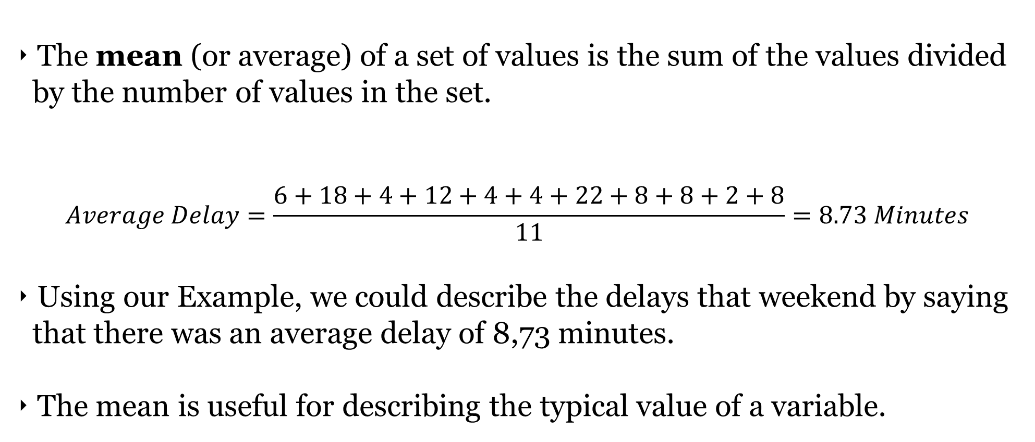
MEAN
The mean (or average) of a set of values is the sum of the values divided by the number of values in the set.
$$Average Delay=\frac{6+18+4+12+4+4+22+8+8+2+8}{11}=8.73 Minutes$$
Using our Example, we could describe the delays that weekend by saying that there was an average delay of 8,73 minutes.
The mean is useful for describing the typical value of a variable.

Slide 12
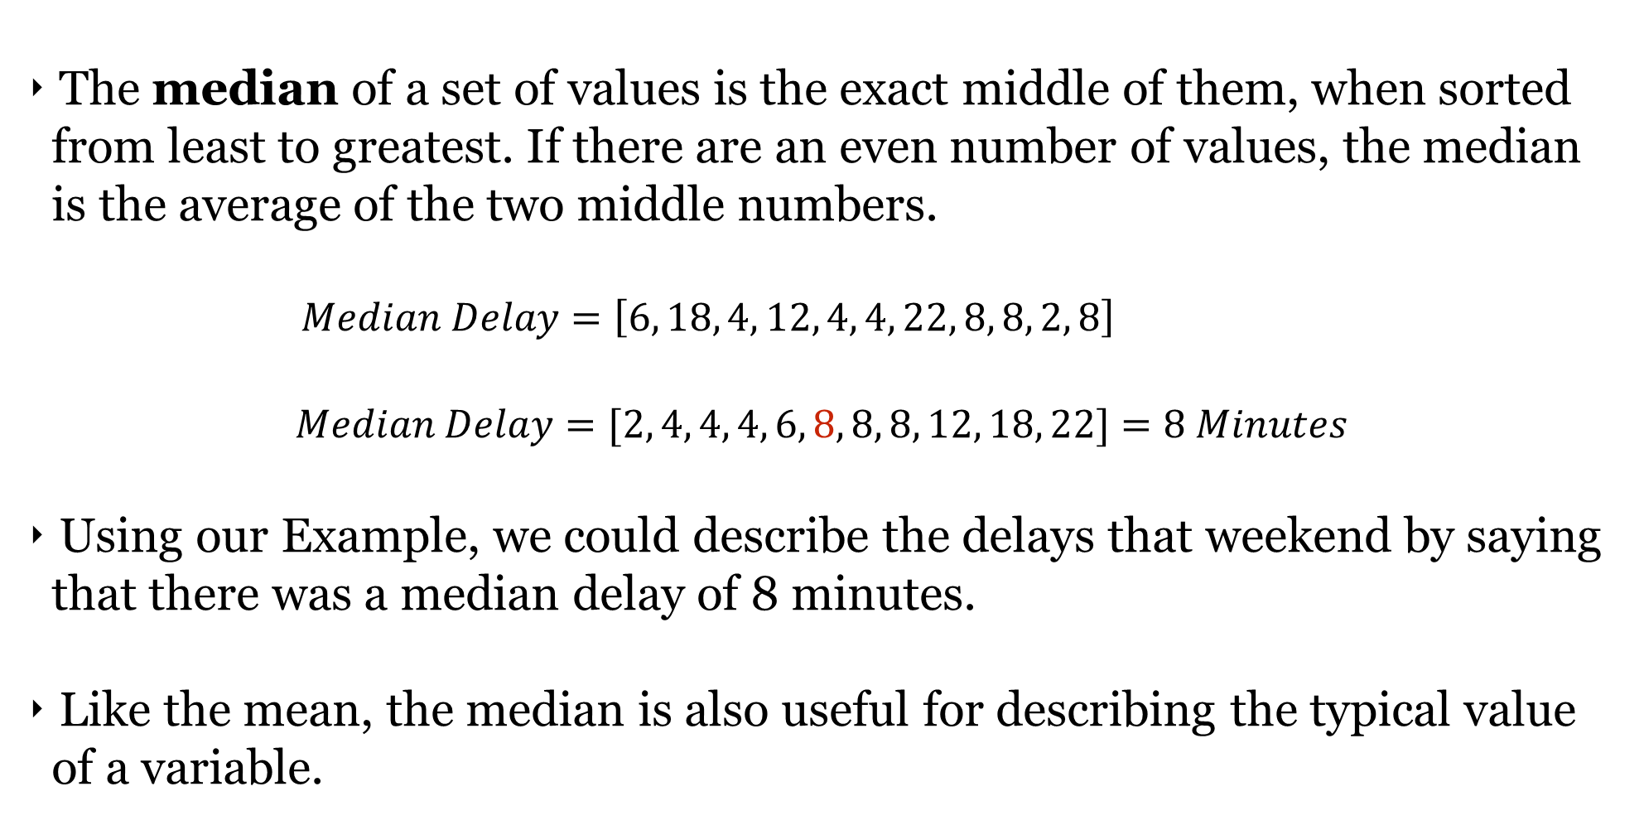
MEDIAN
The median of a set of values is the exact middle of them, when sorted from least to greatest. If there are an even number of values, the median is the average of the two middle numbers.
$$Median Delay=\left[6, 18, 4, 12, 4, 4, 22, 8, 8, 2, 8\right]$$
$$Median Delay=[2, 4, 4, 4, 6, 8, 8, 8, 12, 18, 22]=8 Minutes$$
Using our Example, we could describe the delays that weekend by saying that there was a median delay of 8 minutes.
Like the mean, the median is also useful for describing the typical value of a variable.

Slide 13
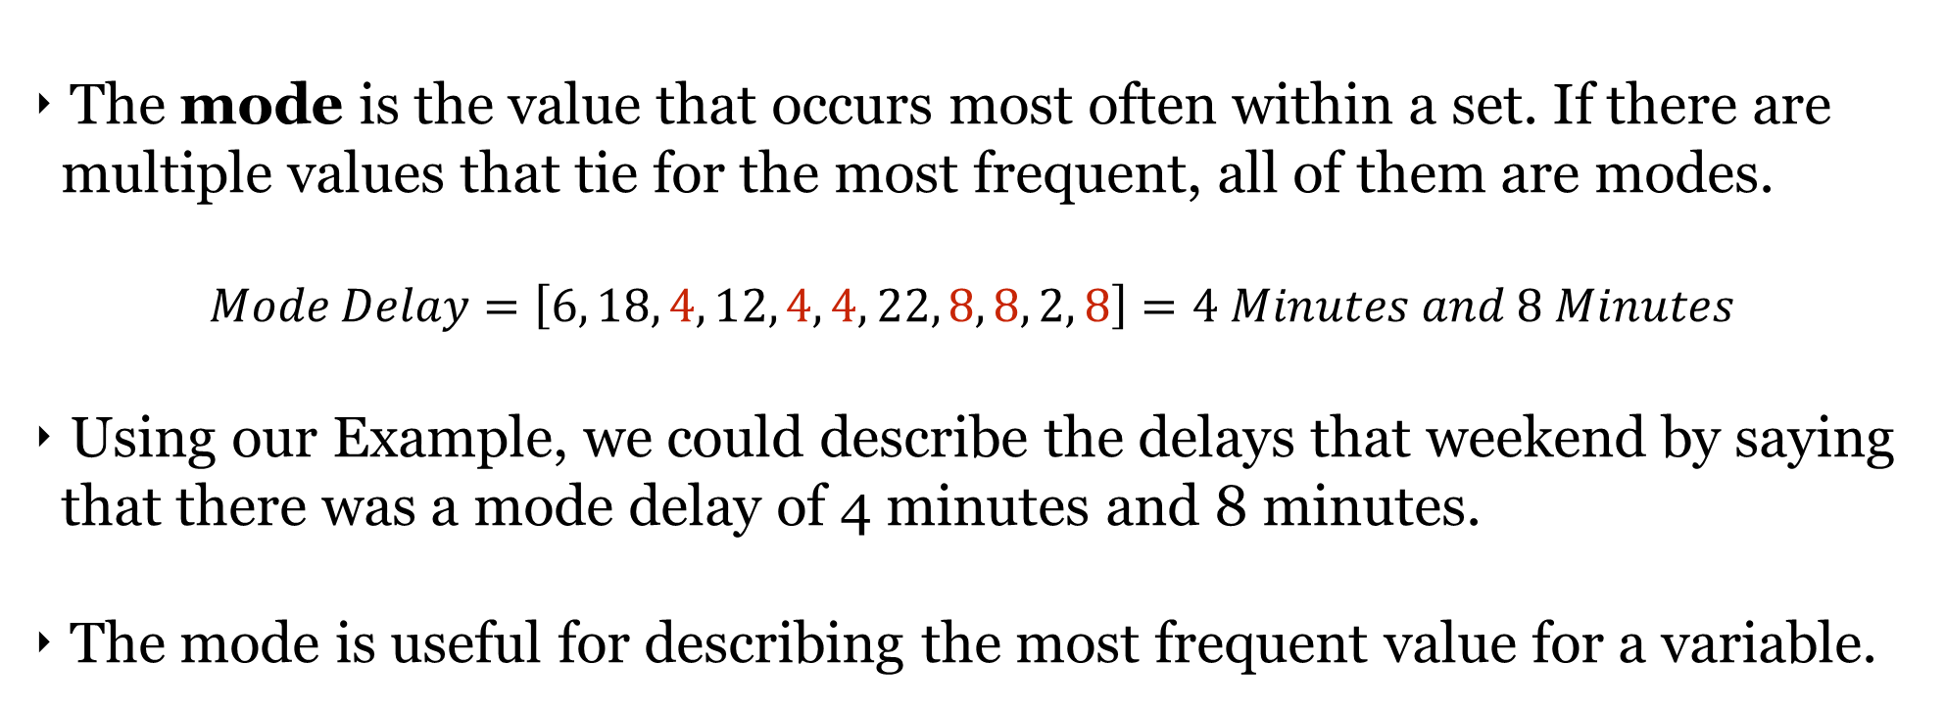
MODE
The mode is the value that occurs most often within a set. If there are multiple values that tie for the most frequent, all of them are modes.
$$Mode Delay=\left[6, 18, 4, 12, 4, 4, 22, 8, 8, 2, 8\right]=4 Minutes and 8 Minutes$$
Using our Example, we could describe the delays that weekend by saying that there was a mode delay of 4 minutes and 8 minutes.
The mode is useful for describing the most frequent value for a variable.

Slide 14
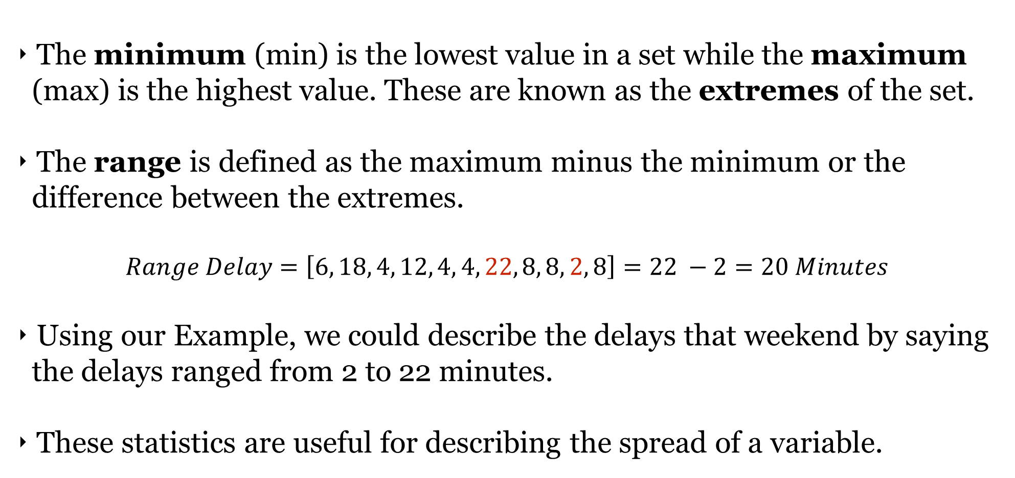
MINIMUM, MAXIMUM, & RANGE
The minimum (min) is the lowest value in a set while the maximum (max) is the highest value. These are known as the extremes of the set.
The range is defined as the maximum minus the minimum or the difference between the extremes.
$Range Delay=\left[6, 18, 4, 12, 4, 4, 22, 8, 8, 2, 8\right]=22 −2=20 Minutes$
Using our Example, we could describe the delays that weekend by saying the delays ranged from 2 to 22 minutes.
These statistics are useful for describing the spread of a variable.

Slide 15

ACTIVITY: KNOWLEDGE CHECK
For the following groups of numbers, calculate the mean, median and mode by hand. Also determine the min, max, and range.
18, 24, 17, 21, 24, 16, 29, 18
75, 87, 49, 68, 75, 84, 98, 92
2. If both the mean and median are supposed to describe the typical values of a variable, why are they sometimes different (e.g. the DC Metro example)?
ANSWER THE FOLLOWING QUESTIONS (5 minutes)
EXERCISE
DELIVERABLE
Answers to the above questions

Slide 16
QUARTILES
Quartiles separate your set into four subsets based on the relative magnitude of the values. For example, the first quartile (Q1) represents the 25% of the data with the lowest values.
How To Find Quartiles
Rank your values by magnitude.
Calculate the Median.
Divide the values in two subsets.
If there are even number of values, make two equal subsets.
Otherwise, include the median in both subsets.
Find the medians of the two subsets.

Slide 17
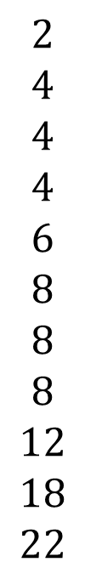
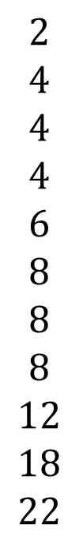
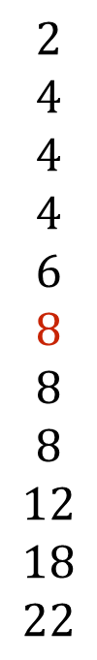
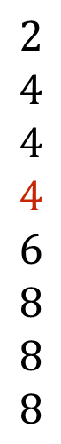
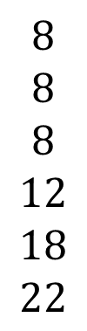
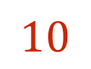
QUARTILES
1
2
3
4
$$2$$
$$4$$
$$4$$
$$4$$
$$6$$
$$8$$
$$8$$
$$8$$
$$12$$
$$18$$
$$22$$
$$2$$
$$4$$
$$4$$
$$4$$
$$6$$
$$8$$
$$8$$
$$8$$
$$12$$
$$18$$
$$22$$
$$2$$
$$4$$
$$4$$
$$4$$
$$6$$
$$8$$
$$8$$
$$8$$
$$8$$
$$8$$
$$8$$
$$12$$
$$18$$
$$22$$
$$2$$
$$4$$
$$4$$
$$4$$
$$6$$
$$8$$
$$8$$
$$8$$
$$12$$
$$18$$
$$22$$
$$10$$
Q1
Quartile | Value
Q1 | 4
Q2 (Median) | 8
Q3 | 10
Q4 (Maximum) | 22
Q2
Q3
Q4

Slide 18
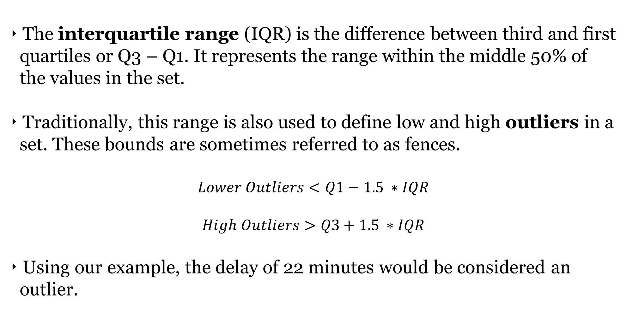
IQR AND OUTLIERS
The interquartile range (IQR) is the difference between third and first quartiles or Q3 – Q1. It represents the range within the middle 50% of the values in the set.
Traditionally, this range is also used to define low and high outliers in a set. These bounds are sometimes referred to as fences.
$$Lower Outliers<Q1−1.5 ∗IQR$$
$$High Outliers>Q3+1.5 ∗IQR$$
Using our example, the delay of 22 minutes would be considered an outlier.

Slide 19
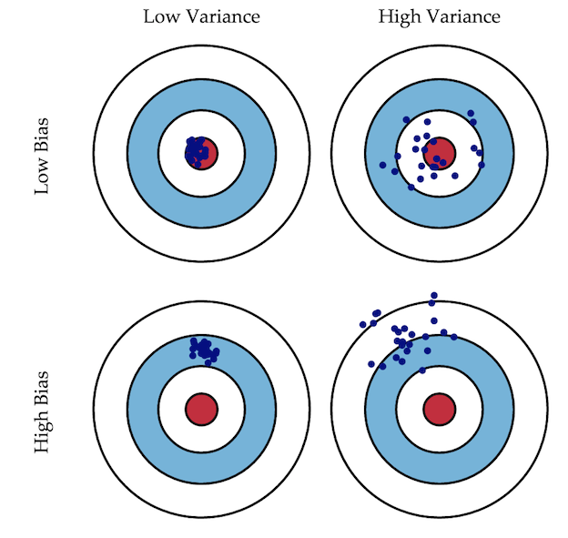
VARIANCE AND STANDARD DEVIATION
Variance represents how much values in the set may deviate or vary from its mean. A high variance indicates that values in the set are regularly far from the mean while a low variance indicates that they are tightly spaced around the mean.
Standard deviation is just the square root of variance.

Slide 20
VARIANCE AND STANDARD DEVIATION
Using our example, the variance of the delays is about 39.42 minutes² and the standard deviation is 6.28 minutes.
Note that variance is always measured in squared units and standard deviation is measured in units. As a result, standard deviation is usually more interpretable.

Slide 21
CODEALONG (PART 1)
SUMMARY STATISTICS

Slide 22
CODEALONG: SUMMARY STATISTICS IN PANDAS
Open the dc-metro-delays notebook located in lessons/lesson-03/code of the class repo.

Slide 23
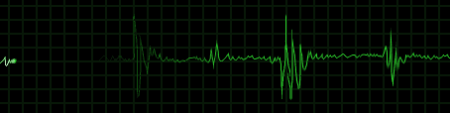
WHY ARE SUMMARY STATISTICS IMPORTANT?
Summary statistics are not terribly complicated, but they are essential building blocks to any analysis. They let you know about the shape of each variable and immediately see any odd or unexpected behavior.
Taking a small amount of time to examine the summary statistics of a dataset can sometimes save an enormous amount of time during the modeling phase.
They are also easy to understand and explain to others!

Slide 24
INTRODUCTION
DISTRIBUTIONS

Slide 25
DISTRIBUTIONS
A distribution is how statistics translates the frequency of each value in a set to the probability (or likelihood) that each value will appear in the set.
The probability of a value is the likelihood that it occurs in the set while the cumulative probability is the likelihood that any value less than or equal to it occurs in the set.
Delay | Frequency | Probability | Cumulative Probability
2 | 1 | 1/11 | 1/11
4 | 3 | 3/11 | 4/11
6 | 1 | 1/11 | 5/11
8 | 3 | 3/11 | 8/11
12 | 1 | 1/11 | 9/11
18 | 1 | 1/11 | 10/11
22 | 1 | 1/11 | 11/11

Slide 26
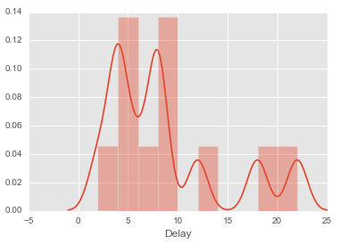
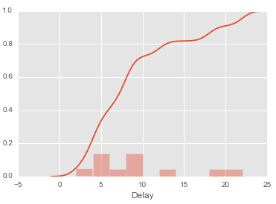
VISUALIZING DISTRIBUTIONS
Here’s how these probability distributions look:
You can see how the modes have a large effect on both distributions.

Slide 27
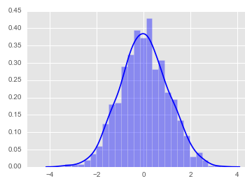
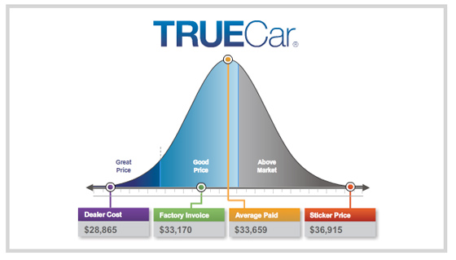
THE NORMAL DISTRIBUTION
The normal distribution (or “bell curve”) is defined as the distribution of values where they are evenly spaced around the mean or when the median equals the mean equals the mode.
It is the most important distribution in statistics because it has a series of mathematical properties that we can use for building complex models.

Slide 28
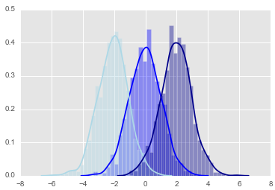
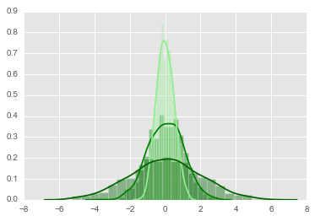
THE NORMAL DISTRIBUTION
The normal distribution is defined by two key parameters– mean and standard deviation.
Changing the mean of the normal distribution shifts it back and forth along the x-axis while changing the standard deviation alters height of the distribution.

Slide 29
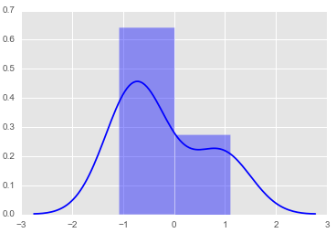
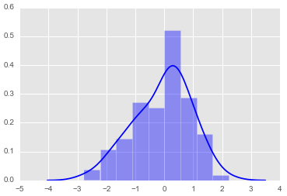
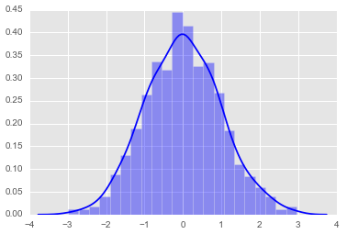
CENTRAL LIMIT THEOREM
The normal distribution is also important because of something called central limit theorem which states that as the sample size of data increases, the distribution of the data will become roughly normal.
Sample Size = 10
Sample Size = 100
Sample Size = 1000

Slide 30
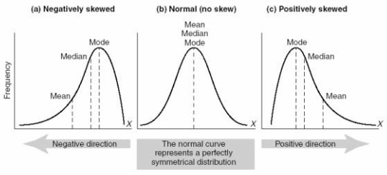
DESCRIBING NON-NORMAL DISTRIBUTIONS
It will often be the case that distribution of real-world data will not be normal due to the nature of how it was collected or measured. As a result, it helps to be able to describe the abnormalities.
Skew is when data is not symmetric around the mean, but more heavily concentrated above or below the mean.

Slide 31
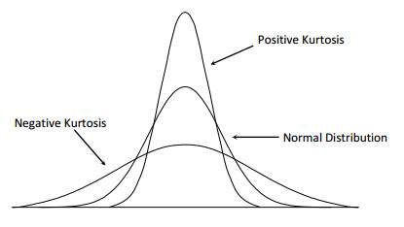
DESCRIBING (NON-)NORMAL DISTRIBUTIONS
Kurtosis refers to the peak and general shape (pointy vs flat) of the distribution curve.
Note that unlike skew normal distributions can have positive or negative kurtosis.

Slide 32
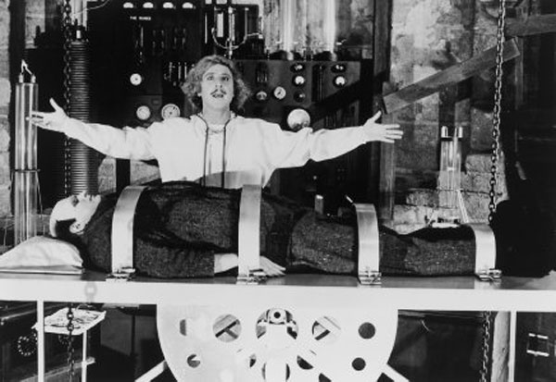
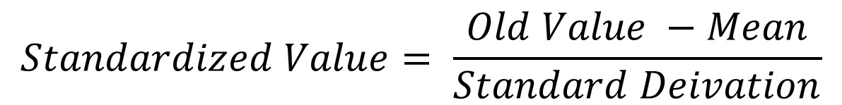
TRANSFORMING DISTRIBUTIONS
There is a way to transform a non-normal distribution into a normal distribution called scaling. This consists of subtracting the mean from every value and then dividing by the standard deviation of a distribution.
This process transforms it into a normal distribution with mean 0 and standard deviation 1.
$$Standardized Value= \frac{Old Value −Mean}{Standard Deivation}$$

Slide 33
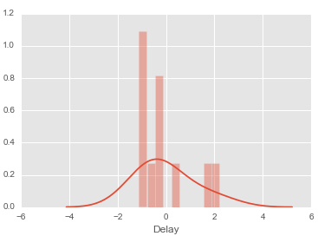
TRANSFORMING DISTRIBUTIONS
Here’s what it would look like with our example data:
Delay | Scaled Delay
8 | -0.121
8 | -0.121
2 | -1.124
8 | -0.121
6 | -0.456
18 | 1.549
4 | -0.790
12 | 0.547
4 | -0.790
4 | -0.790
22 | 2.217

Slide 34
CODEALONG (PART 2)
DISTRIBUTIONS

Slide 35
DETERMINING THE DISTRIBUTION OF YOUR DATA
Open the dc-metro-delays notebook located in lessons/lesson-03/code of the class repo.

Slide 36
GUIDED PRACTICE
DISTRIBUTION LINEUP

Slide 37
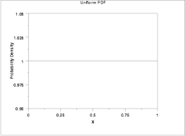
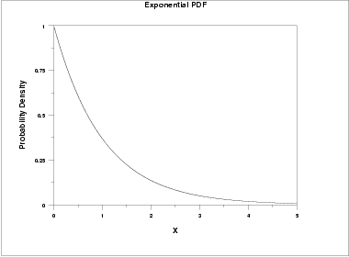
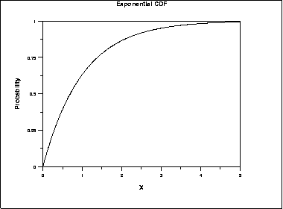
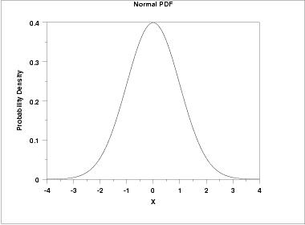
ACTIVITY: DISTRIBUTION LINEUP
DIRECTIONS (10 minutes)
EXERCISE
For each image, determine whether the image is:
Normal or non-normal
Positively, negatively, or not skewed
Has positive, negative, or zero kurtosis
What about the DC Metro delay data?

Slide 38
INTRODUCTION
VARIABLE TYPES

Slide 39
VARIABLE TYPES
There are two types of variables – numeric/continuous and categorical/discrete.
Numeric/continuous variables can are measured across a large range of quantitative values (e.g. height, income).
Categorical/discrete variables are measured using several specific values that have no sensible intermediary values (e.g. hair color).
Some models will only accept numeric variables and others will accept both numeric and categorical data so it’s important to know what variables we’re working with.

Slide 40
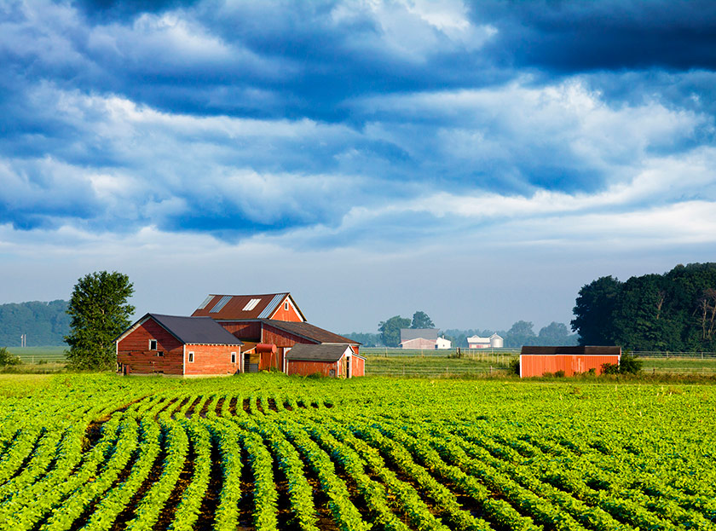
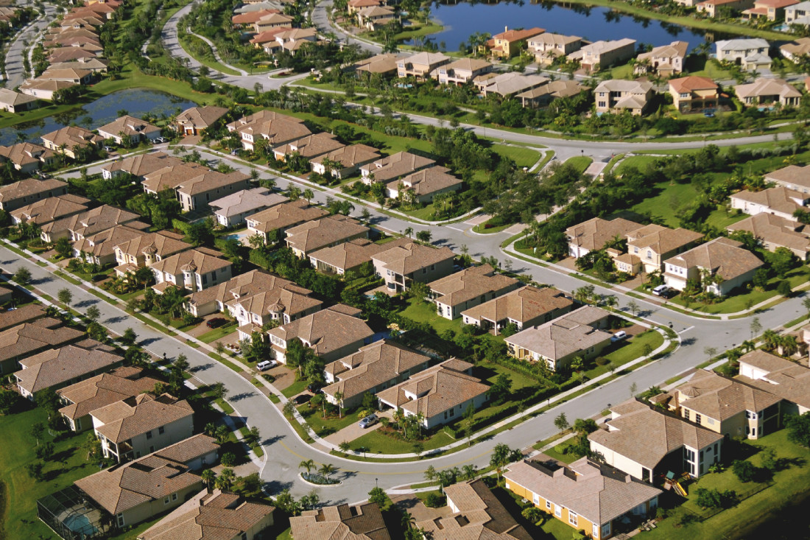
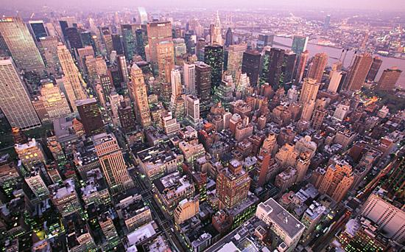
CLASS/DUMMY VARIABLES
Let’s say we have a categorical variable area, which takes on one of the following values: rural, suburban, and urban.
If we needed to represent these numerically for a model, how would we represent this variable?

Slide 41
CLASS/DUMMY VARIABLES
Does an ordinal coding scheme (0=rural, 1=suburban, and 2=urban) work for our model?
Not likely because of the two following problems:
Are urban areas 2x suburban areas? What does that even mean?
Is there a reason that we ordered the variables in this way?

Slide 42
CLASS/DUMMY VARIABLES
The solution is something called dummy variables where we convert the area variable into a series of binary (0/1) variables.
We’ll need n-1 dummy variables where n is the number of unique values or levels of our categorical values.
 | area_urban | area_suburban
rural | 0 | 0
suburban | 0 | 1
urban | 1 | 0

Slide 43
CLASS/DUMMY VARIABLES
This solves the drawbacks or ordinal coding by not implying that there is an order or magnitude type relationship between the different categories.
We only need two variables because we can derive all of the possible values from these two. If an area isn’t urban or suburban, we know it must be rural.
The level that is encoded as all zeroes (e.g. rural) is called our reference category because model output will return results relative to it.
As a rule of thumb, it’s often good to choose the category with the largest sample size or a criteria that will help model interpretation.
If we are testing for a disease, the reference category would be people without the disease.

Slide 44
INDEPENDENT PRACTICE
DUMMY COLORS

Slide 45
ACTIVITY: DUMMY COLORS
It’s important to understand the concept before we use the Pandas function get_dummies to create dummy variables. So today, we’ll create our dummy variables by hand.
Create dummy variables for the lines in the DC Metro that has 6 categories: blue, red, green, orange, silver , and yellow. Use silver as the reference.
Refer back to our DC Metro delay data for the weekend of 8/20. Which line should be the reference variable? Why?
DIRECTIONS (15 minutes)
EXERCISE
DELIVERABLE
Dummy variables table for colors

Slide 46
INDEPENDENT PRACTICE
MORE DELAYS

Slide 47
CODEALONG: SUMMARY STATISTICS IN PANDAS
Open the starter-code-3 notebook located in lessons/lesson-03/code/starter-code of the class repo.
Feel free to reuse any code we went over during the codealong.

Slide 48
CONCLUSION
TOPIC REVIEW

Slide 49
REVIEW
We talked about several different types of summary statistics, what are they?
We covered several different types of visualizations; which ones?
We talked about the normal distribution; how do we determine your data’s distribution?

Slide 50
LESSON
Q & A

